Slide 1

Optimized Warehouse Management Of Perishable Goods For A Food Delivery Company
Team AppyFuzz

Slide 2
Introduction
Problem Statement
This project is part of IBM Hack Challenge 2020. The goal of this project is to help in the optimized warehouse management for perishable goods for a food delivery company, and to that extent offers a demand prediction machine learning model.

Slide 3
Introduction
Proposed solution
Given the data for the past X weeks, say with columns suggesting the meal id, the type of cuisine, and number of orders, prices of the meals, discounts offered, fulfilment centers, we propose the following:
We have segregated the data according to :
● cuisine,
● meal id,
● fulfillment center id, and
● category type,
We predict the demand of various meals according to the above categories for the next Y weeks, using various regressors such as RandomForest, XGBooster, CatBooster, to name a few. All the above predictions, are represented in the form of charts to visually aid the user, in understanding the number of orders expected in the coming weeks.

Slide 4
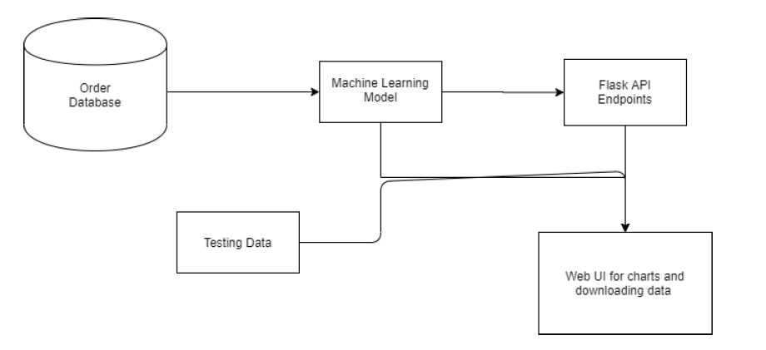
Use Case

Slide 5
Results
We have used XGBRegressor as our machine learning model, for forecasting demand predictions. The results have been communicated to the web application with the help of Flask API endpoints. The data from the API enpdoints have been represented in the form of charts in the web application, and also have been made available or downloading. The charts in the web application have four categories: meal_id, center_id, category, cuisine. Corresponding to each category charts, both training and testing, have been showcased for the user's convinience. In addition the home page sports an interactive form where the user can input the data, and see the predicted orders corresponding to his input.

Slide 6
Thank You!!
Team Appy Fuzz
Amrita Das
Shreyasis Roy
Ankita Thakur
Muttashim Sarkar

